Slide 1
Tracking all of your personal notes using the Evernote API
Notes:
[Mandatory Slide] This would be the introduction slide of the topic that you are covering in this subsection.
When this slide plays, you could talk about the main aim that we’d be covering in this video.

Slide 2
In this Video, we are going to take a look at…
Setup your Evernote account
Setup the Evernote Python SDK
Code sample
Notes:
[Mandatory Slide]
Before the start of the video, we’d like to highlight what are important topics or pointers that we’d be covering in this video. This slide would immediately follow the intro/name slide. This would just be say 2-3 points for the viewers to know what they are getting into.

Slide 3
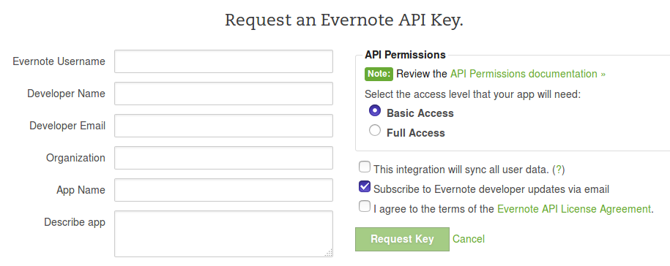
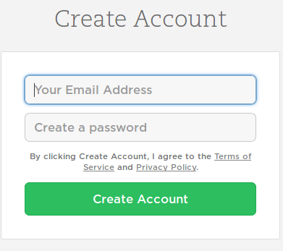
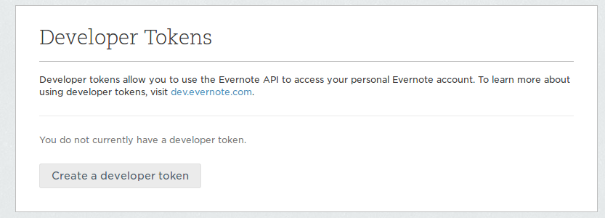
Setup your Evernote account
If you don’t already have one, open up a new Evernote account at http://evernote.com
Go to https://dev.evernote.com/#apikey and ask for a new API key: fill in the requested info and specify a Basic Access permission profile
The API key is activated on the Evernote Sandbox Server (https://sandbox.evernote.com): you need to register a new account on that server, as we will use that one
Go to https://sandbox.evernote.com/api/DeveloperToken.action and obtain a Developer Token
Notes:
[Mandatory Slide]
Before the start of the video, we’d like to highlight what are important topics or pointers that we’d be covering in this video. This slide would immediately follow the intro/name slide. This would just be say 2-3 points for the viewers to know what they are getting into.

Slide 4
Setup the Evernote Python SDK
The Evernote Python 3 SDK can be easily installed with: pip install evernote3
The Evernote API represents the contents of notes with a markup language called ENML, which is a subset of XHTML. More about it at: https://dev.evernote.com/doc/articles/enml.php
Notes:
[Mandatory Slide]
Before the start of the video, we’d like to highlight what are important topics or pointers that we’d be covering in this video. This slide would immediately follow the intro/name slide. This would just be say 2-3 points for the viewers to know what they are getting into.

Slide 5
Code sample
Notes:
Something that needs to grab the viewers attention!!

Slide 6
Summary
Setup your Evernote account
Setup the Evernote Python SDK
Code sample
Notes:
[Mandatory Slide]
Before the start of the video, we’d like to highlight what are important topics or pointers that we’d be covering in this video. This slide would immediately follow the intro/name slide. This would just be say 2-3 points for the viewers to know what they are getting into.

Slide 7
Watching for topics on the Python Reddit RSS feed
Next Video
Notes:
[Mandatory Slide]
Here the name of the next video needs to be mentioned. The narration as you guessed it would be just letting the viewer know exactly where we are at and what we’d be taking over next! ☺

